Slide 1
ROAD VEHICLE ANALYSIS
Team Members
1.VISHALI R-1917303
2.DEEPAN P-1917L04
3.VIJAY P-1917152
4.SENTHIL NAYAGAN S-1917L13
PROJECT GUIDE
Dr.K.KUMAR

Slide 2
INTRODUCTION
Vehicle detection and classification hold an essential place in traffic surveillance systems and traffic safety.
It plays an important role in vehicle detection systems, automatic video surveillance and also to avoid collision.
This project proposes a method to estimate the speed of vehicles on the highways and city areas.
The proposed method can be effectively implemented to control the over speed vehicles and to found guilty in leading to traffic accidents. Each vehicle in the video recorded by the camera is identified.

Slide 3
NEED FOR VEHICLE DETECTION
Smart Parking System Management
Smuggling of Cars or bikes
Usage of cars in terrorist attacks/illegal activities.

Slide 4
SOCIAL IMPACTS
Detection of vehicle speed can play a vital role in maintaining road safety. It can help identify vehicles that are violating speed limits and pose a risk to other driver.
By using this road vehicle analysis we can store the information about each and every vehicles which are captured by the camera it will be useful for crime prediction.

Slide 5
EXISTING SYSTEM
In Existing system various sensors used to detect the speed of the vehicle.
Sensor examples- Radar, RF Transmitter, Ultrasonic Sensor, LIDAR used for Vehicle speed estimation and to detect the speed of the vehicle but the cost is high.
Now a day camera is used to detect the vehicle using the CNN (Convolution Neural Network) . It is highly efficient but the loss may occur and failed to detect the direction of the vehicle.

Slide 6
PROBLEM STATEMENT
Develop a DNN Model that can accurately detect vehicles in a video stream, classify their types, determine their colors, and estimate their speeds.

Slide 7
PROPOSED SYSTEM
To overcome the loss we using DNN (Deep Neural Network) to detect type of the vehicle and speed of the vehicle.
Once the vehicles are detect, we can determine the speed of vehicles on the road by OpenCV.
Our project is also predict the type and color of the vehicle and the information is stored for future purpose.

Slide 8
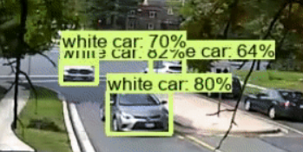
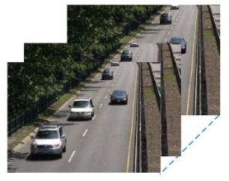
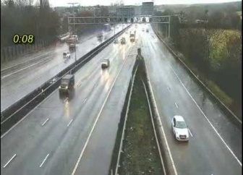
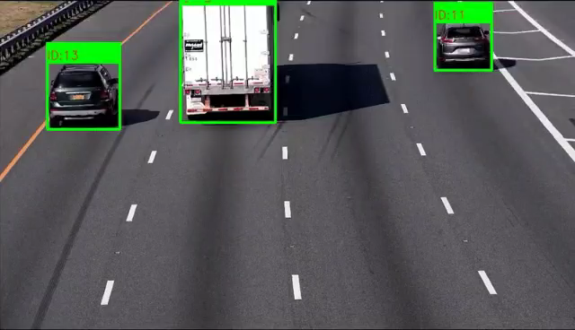
WORK FLOW
Detected Vehicle Image
Color recognition by KNN is trained with color histogram
Color Recognition Module
Color of the Vehicle
DNN vehicle detection module
frame
Prediction of the speed and direction using pixel locations
Speed and Direction of the Vehicle
Read input video frame by frame with OpenCV
Detected Vehicle Image Pixel Locations
Speed & Direction Prediction Module

Slide 9
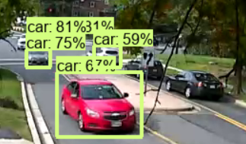
vehicle detection
Input
Video
Read frame by
frame by OpenCV
COCO dataset
Train the DNN
model
Trained DNN
model
Detect the vehicle
and draw box
around the vehicle

Slide 10


Color Recognition
Colors are classified by using KNN algorithm. This classifier is trained by image R, G, B Color Histogram values.
Detected
vehicle image
Feature Extraction
Feature
vector
KNN model
Finding K-nearest training samples
Labeled Training images
Predict color of
the vehicle

Slide 11
SPEED ESTIMATION
Total time taken for a vehicle to pass the screen can be found from dividing image width by frame rate.
Speed of the vehicle is then found from dividing the multiplication of real world distance and pixel distance by total time.
Total time = Image width / Frame rate
Speed = (Pixel distance * real world distance)/ Total time.

Slide 12
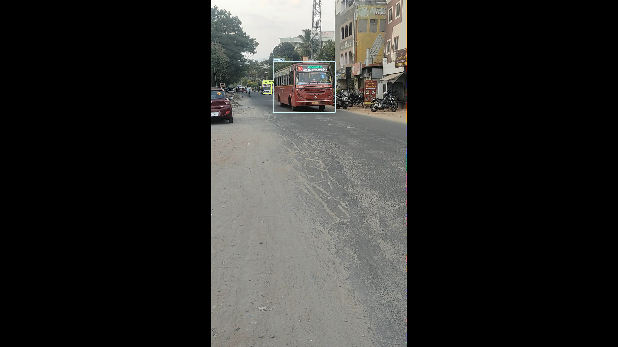
IMPLEMENTATION – vehicle detection

Slide 13
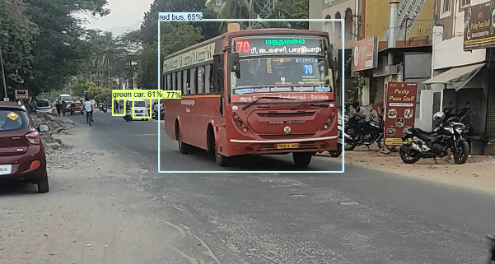
IMPLEMENTATION – vehicle colour detection

Slide 14
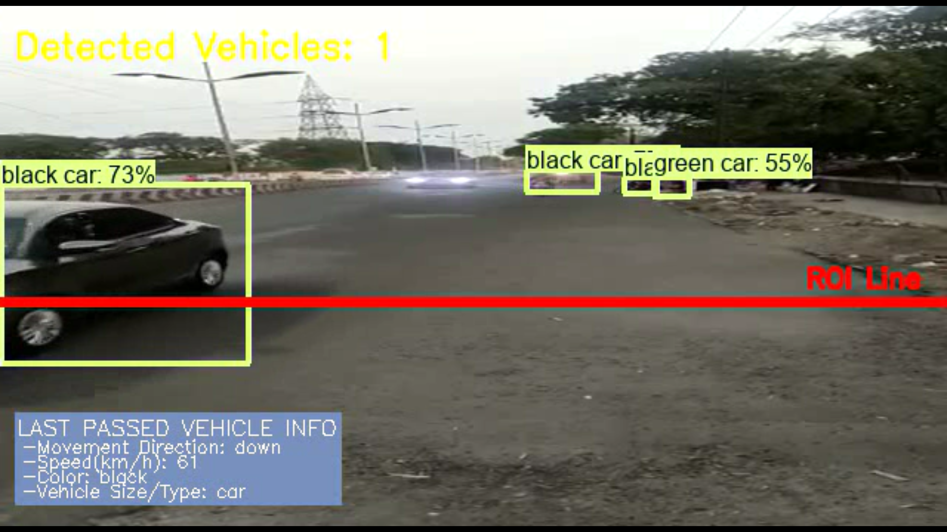
IMPLEMENTATION – speed and direction detection

Slide 15

IMPLEMENTATION

Slide 16
CONCLUSION
The project aims at determining vehicle speed which is necessary for traffic surveillance systems.
The system use image processing techniques for identifying the vehicle from the database stored in the computer.
It will be used to monitor and manage various traffic conditions such as traffic management, prevention of accident.

Slide 17
REFERENCES
Pavel Najman and Pavel Zem “Vehicle Speed Measurement Using Stereo Camera Pair” IEEE TRANSACTIONS ON INTELLIGENT TRANSPORTATION SYSTEMS, VOL. 23, NO. 3, 2022.
Ranjeeth kumar.C “Multiple vehicles tracking and detection using weight high order singular value decomposition dimensionality reduction and double classifiers” journal of intelligent and fuzzy system, 2022.
R.Roopa Chandrika and K.M.Karthick Raghunath“Vehicle Detection and Classification using Image processing”,2021.
Xizhi Hu, Zheng Wei, Wenchao Zhou “A video streaming vehicle detection algorithm based on YOLOv4”,2021.
SEDA KUL , ISABEK TASHIEV, ALI ŞENTAŞ, AND AHMET SAYAR “Event-Based Microservices With Apache Kafka Streams: A Real-Time Vehicle Detection System Based on Type, Color, and Speed Attributes” 2021 Digital Object Identifier 10.1109/ ACCESS. 2021. IEEE

Slide 18
Shivanand S Gornale and Pravin L Yannawar “Analysis and Detection of Content based Video Retrieval” I.J. Image, Graphics and Signal Processing, 2019.
Mei yan, Menglin Li and He Hongwen “Deep Learning for Vehicle Speed Prediction” a National Engineering Laboratory for Electric vehicle ,school of Mechanical engineering Beijing Institute of Technology 2018.
John Michael Scanlon “Earliest Sensor Detection Opportunity for Left Turn Across Path Opposite Direction Crashes” IEEE TRANSACTIONS ON INTELLIGENT VEHICLES, VOL. 2, NO. 1, MARCH 2018.
Ankur Dumka “Design and Construction of Speed Detection System for Vehicles”IJRTE ,VOL.2,AUGUST 2019.

Slide 19
Ayatullah Faruk Mollah,Nabamita Majumder Subhadip Basu“ Design of an Optical Character Recognition System For Camera-Based Handheld Devices” IJCSI,VOL.8,Issue 4,No 1,JULY 2018.
Shreevallabhadatta G“Automobile Number Plate Recognition and Extraction Using Optical character Recognition”2018 IJIRAE,VOL.1,Issue 1,APRIL 2018.

Slide 20
Thank you !

